Slide 1


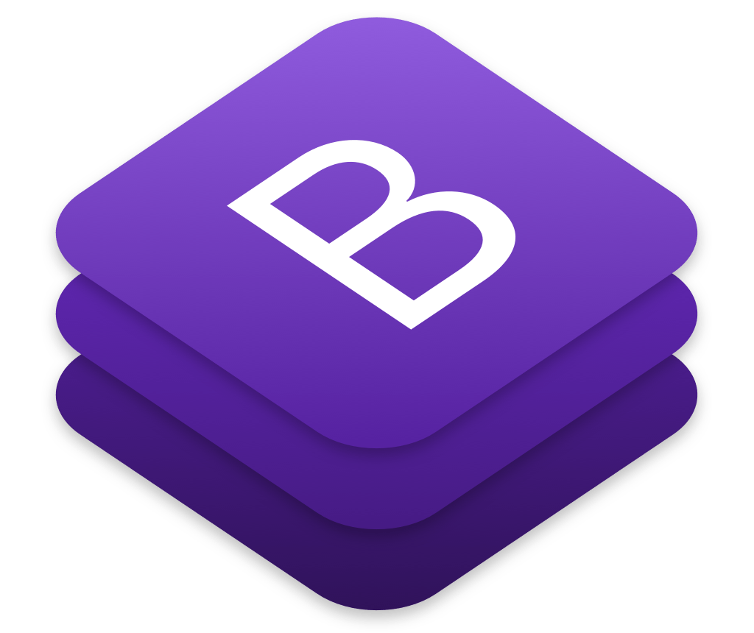
INTRODUCTION TO BOOTSTRAP 5
PRESENTER: SIR MOHAMMAD ADIL

Slide 2
What Is Bootstrap ?
Bootstrap is a free front-end framework for faster and easier web development.
Bootstrap includes HTML and CSS based design templates for typography, forms, buttons, tables, navigation, modals, image carousels and many other, as well as optional JavaScript plugins

Slide 3
Built-in classes
.Myclass
{
Text-align:center;
Color:red;
}

Slide 4
What is Bootstrap ?
Bootstrap also gives you the ability to easily create responsive designs (RWD).

Slide 5
What is Responsive Web Design ? (RWD)
Responsive web design is about creating web sites which automatically adjust themselves to look good on all devices, from small phones to large desktops.

Slide 6
Very Important Point
We can use css media queries for design the responsive web design.
But a huge drawback of using css media queries, that is lengthy coding.

Slide 7
INTRODUCTION TO BOOTSTRAP 5
Bootstrap 5 is the newest version of Bootstrap, which is the most popular HTML, CSS, and JavaScript framework for creating responsive, mobile-first websites.
Bootstrap 5 is completely free to download and use!

Slide 8
Bootstrap 5 vs. Bootstrap 3 & 4
Bootstrap 5 is the newest version of Bootstrap; with new components, faster stylesheet and more responsiveness.
Bootstrap 5 supports the latest, stable releases of all major browsers and platforms. However, Internet Explorer 11 and down is not supported.

Slide 9
Bootstrap 5 vs. Bootstrap 3 & 4
The main differences between Bootstrap 5 and Bootstrap 3 & 4, is that Bootstrap 5 has switched to JavaScript instead of jQuery.
Note: Bootstrap 3 and Bootstrap 4 is still supported by the team for critical bugfixes and documentation changes, and it is perfectly safe to continue to use them. However, new features will NOT be added to them.

Slide 10
Bootstrap Versions
Bootstrap 5 (released MAY 05 2021) is the newest version of Bootstrap (released 2013); with new components, faster stylesheet and more responsiveness

Slide 11
Why Use Bootstrap?
Advantages of Bootstrap:
Easy to use: Anybody with just basic knowledge of HTML and CSS can start using Bootstrap.
Responsive features: Bootstrap's responsive CSS adjusts to phones, tablets, and desktops

Slide 12
Why Use Bootstrap?
Advantages of Bootstrap:
Mobile-first approach: In Bootstrap, mobile-first styles are part of the core framework
Browser compatibility: Bootstrap 5 is compatible with all modern browsers (Chrome, Firefox, Edge, Safari, and Opera). Note that if you need support for IE11 and down, you must use either BS4 or BS3.

Slide 13
Amazing thing about this lecture series
I am going to give you tasks or exercises after every video lecture for practice.

